Slide 1
ORDER YOUR CULINARY ARTIST
PRESENTED BY:
GUIDE:W.NIRMALA
Grandhe Eshwara Sai Anirudh-17N31A0573
Gunda Vyshnavi-17N31A0577
Gundreddy Sahith Reddy-17N31A0578
Gouru Srinivas-18N35A0507

Slide 2
Agenda:
ABSTRACT
INTRODUCTION
EXISTING SYSTEM
PROPOSED SYSTEM
SOFTWARE AND HARDWARE REQUIREMENTS
ARCHITECTURE
UML DIAGRAM
CODE STRUCTURE
MODULES
OUTPUT
CONCLUSION AND FUTURE WORK
REFERENCES

Slide 3
ABSTRACT
This is a service-oriented web application where people can book a chef, and chefs services are provided accordingly, developed using Node.js,MongoDB and Expressjs. Customer can enjoy a customized culinary experience with a Private Chef - all in the comfort of your own home.

Slide 4
INTRODUCTION
A few hours prior to your private dining experience, your personal chef will arrive and begin preparing the menu agreed upon. Watch and learn new recipes from your chef as he cooks in your home kitchen. With our discreet and professional service, we guarantee customers can enjoy with nothing to worry about.

Slide 5
EXISTING SYSTEM
Going to restaurant or hotel to enjoy chef’s food where we need to travel to the place, not under our surveillance, sometimes unhygienic , with constricted, less freedom and pay high cost for food.

Slide 6
PROPOSED SYSTEM
Chef coming to our home or said place along with ingredients where we need not to travel to the place, under our surveillance, hygienic , with freedom and pay moderate cost for food.
Billing is done through communication between the user and chef by the provided chef details to the user.

Slide 7
SOFTWARE REQUIREMENTS
HTML5, CSS, nodejs, mongodb ,expressjs and npm.
Any latest browser
HARDWARE REQUIREMENTS
Operating system: windows 8 or later
Processor : Intel core I3
RAM : 4 GB minimum
Screen resolution: 1280x 1024 or larger
Hard disk : 500GB

Slide 8
ARCHITECTURE
MODEL VIEW CONTROLLER
Model: Model represents the shape of the data. Model objects store data retrieved from the database.
View: View in MVC is a user interface. View display model data to the user and also enables them to modify them. Ex.View in our project MVC is HTML, CSS, and some special syntax (Snippet Code) that makes it easy to communicate with the model and the controller.
Controller: The controller handles the user request. Typically, the user uses the view and raises an HTTP request, which will be handled by the controller. The controller processes the request and returns the appropriate view as a response.

Slide 9
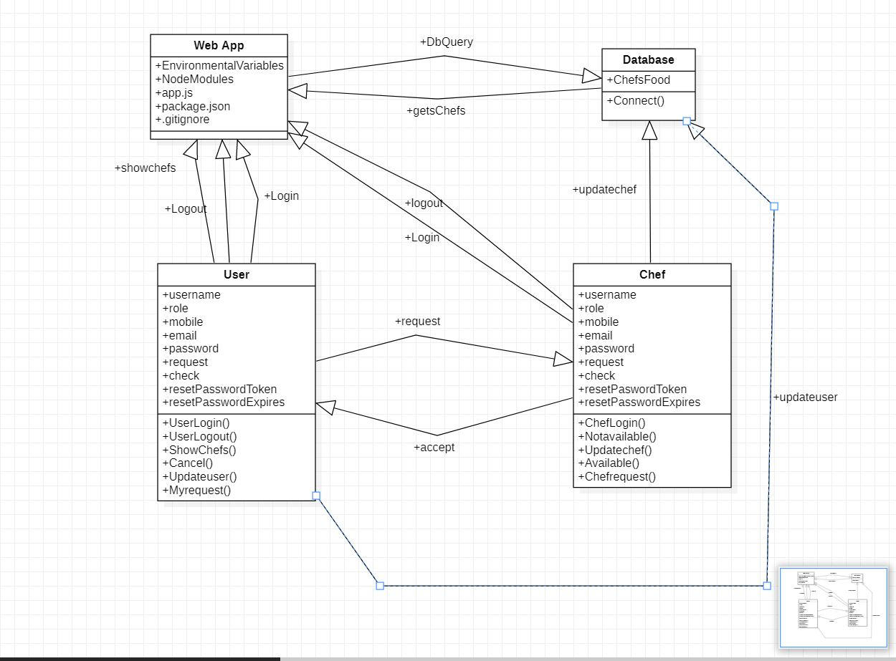
UML DIAGRAM

Slide 10
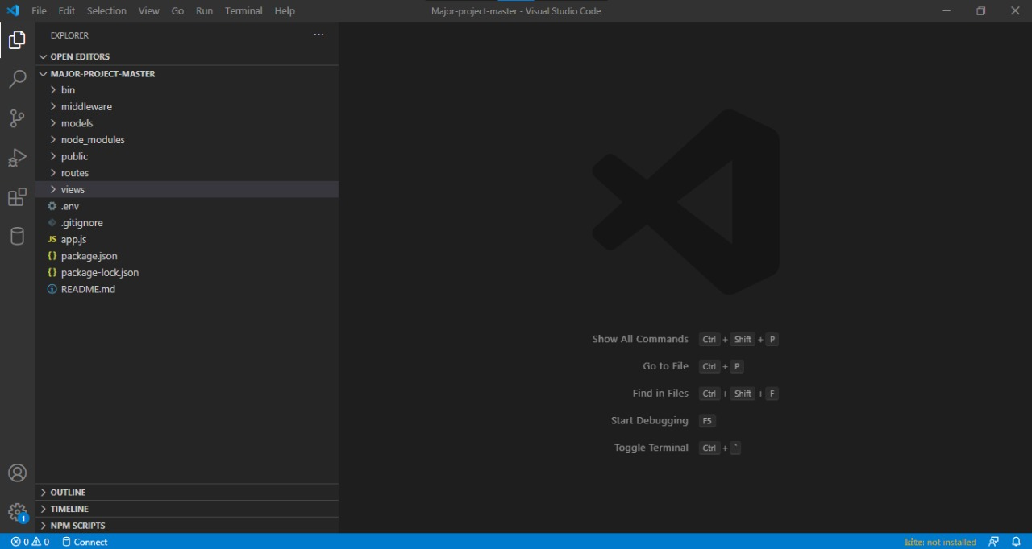
Code structure

Slide 11
MODULES
USER MODULE:
SHOW CHEFS
CANCEL
MY REQUESTS
EMERGENCY
DELETE MY ACCOUNT
USER SIGNUP
USER LOGIN
CHEF MODULE:
SET NOT AVAILABLE
SET AVAILABLE
CHEF LOGIN
CHEF REQUESTS
EMERGENCY
ADMIN MODULE:
CHEF REGISTER
DELETE CHEF
VIEW ALL RECENT ORDERS
VIEW ALL CHEFS

Slide 12
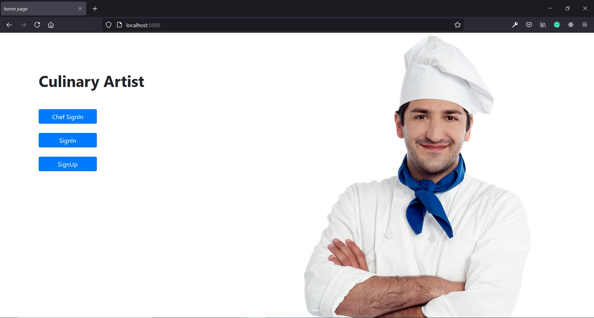
OUTPUT

Slide 13
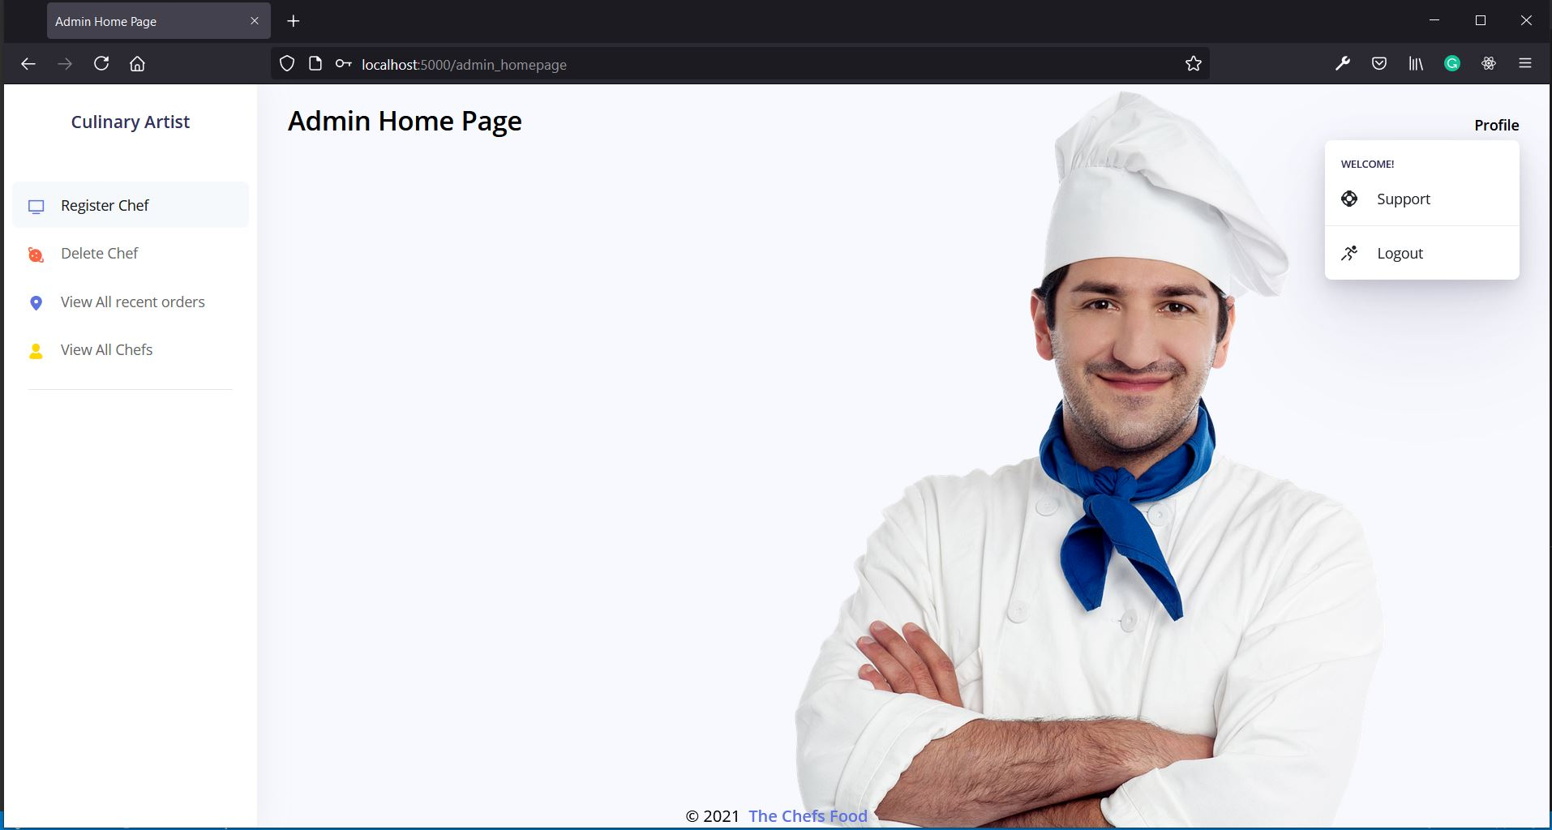
OUTPUT

Slide 14
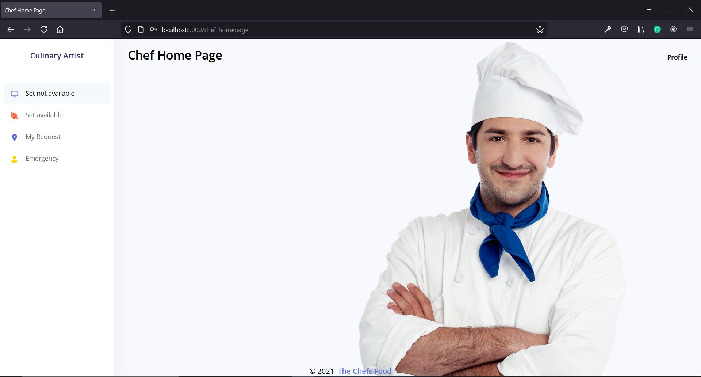
OUTPUT

Slide 15
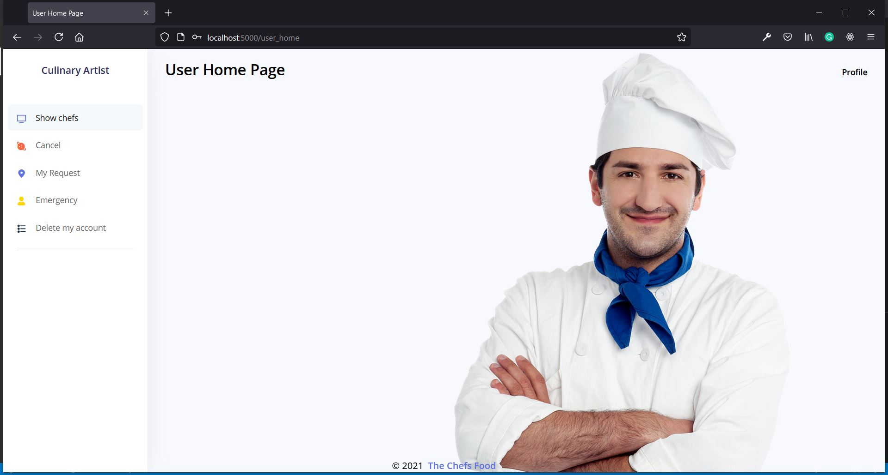
OUTPUT

Slide 16
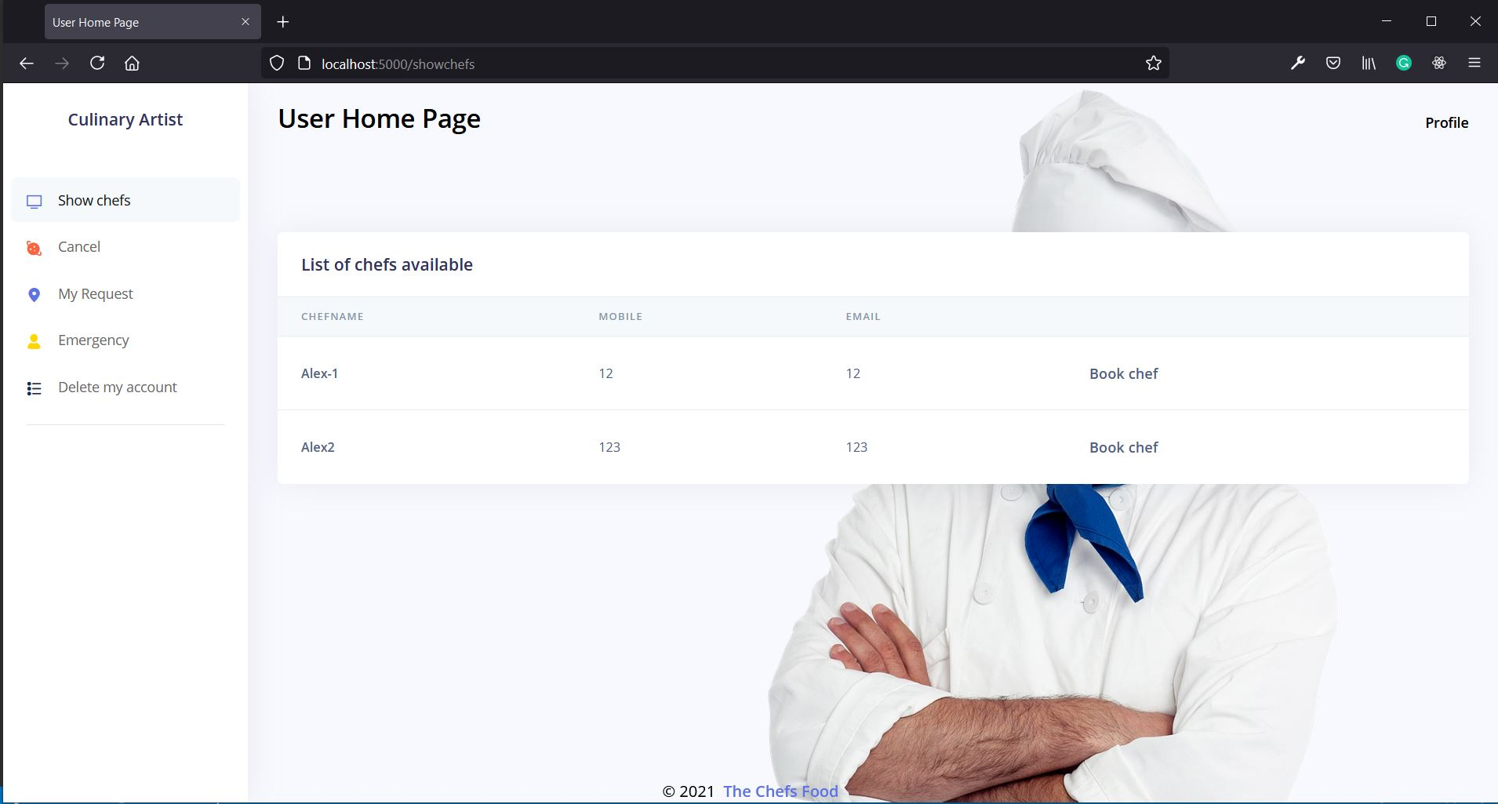
OUTPUT

Slide 17
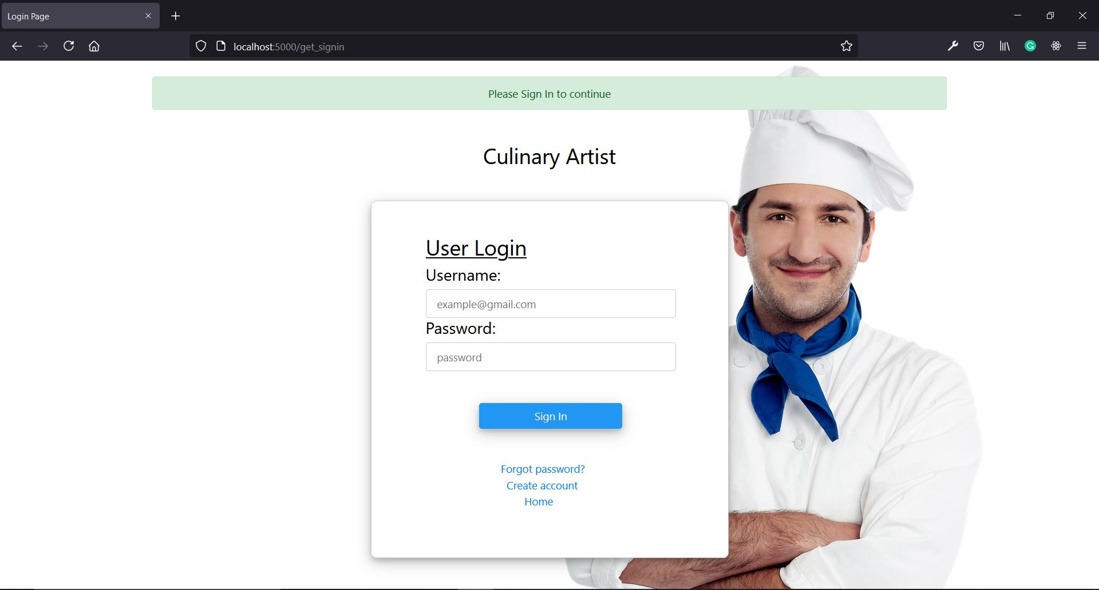
OUTPUT

Slide 18
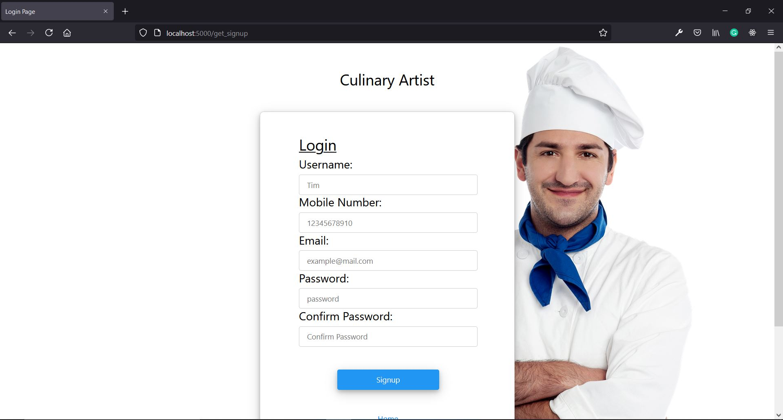
OUTPUT

Slide 19
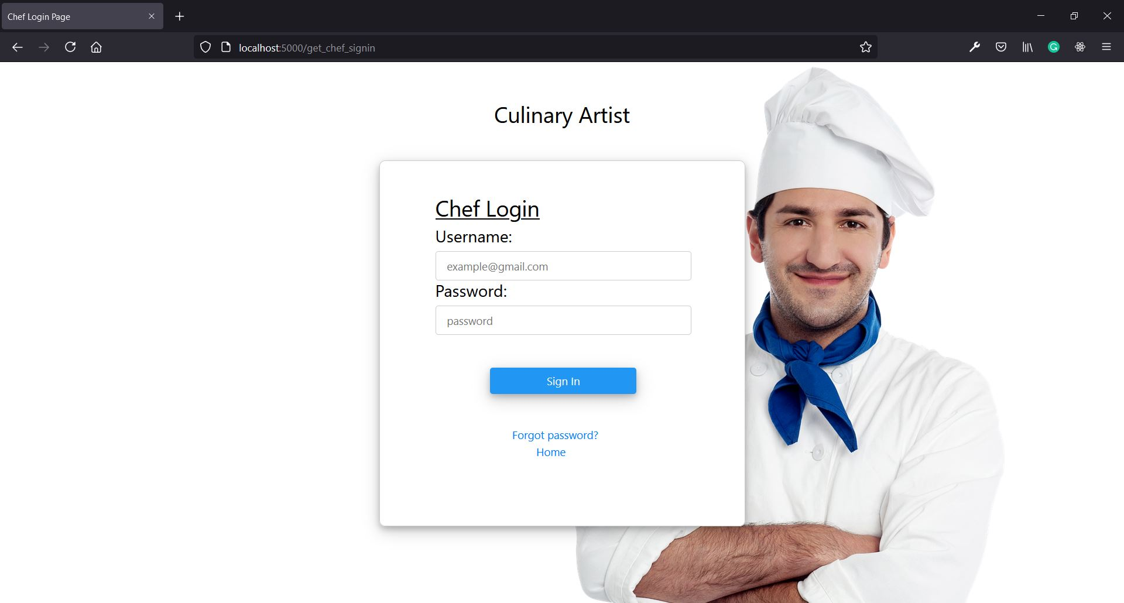
OUTPUT

Slide 20
CONCLUSION AND FUTURE WORK
Thus, by using our chef’s food we tried to increase the hygiene of our food which is essential in present days.
In future we would like to add some more functionality where chef can chat with the chef.
We would like to add the chef booking options like for hourly-basis or for whole day.

Slide 21
REFERENCES
bcrypt
https://github.com/kelektiv/node.bcrypt.js#readme
bootstrap
https://getbootstrap.com/docs/5.0/getting-started/introduction/
mongoose
https://mongoosejs.com/docs/guide.html
nodemailer
https://github.com/nodemailer/nodemailer

Slide 22
THANK YOU

